Slide 1
PHP First Look
By: Akshay R Sonavane

Slide 2
Index

Slide 3
Prerequisite
Basic understanding of computer programming.
Internet, HTML WEB-Development.
Idea about Scripting language, Database, and MySQL.

Slide 4
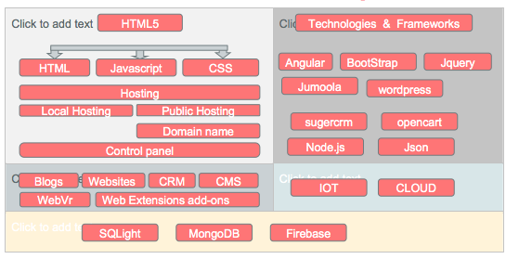
Structure Web Development

Slide 5




+

Slide 6
Introduction
PHP Hypertext Preprocessor (PHP) .
PHP Is an Server side , Scripting language .
PHP allows web developers to create dynamic content that interacts with databases.
add, delete, modify elements within your database.
Access cookies variables and set cookies.
Using PHP, you can restrict users to access some pages of your website. It can encrypt data.

Slide 7
PHP Environment
PHP file can’t be run directly ; it can run only when it is stored in server side .
PHP Code can be embedded in HTML Code , But the HTML file should be stored in .PHP extension instead of .HTML .
The PHP code is always written in tags like HTML , Starting tag for PHP is “<?php” and ending tag is “?>”.
Commentes Comments in code act as notes to people reading the code. PHP supports C, C++, and shell script–style comments. (single line“//”, multi line’/*….*/,and “#”

Slide 8
Why PHP ?
PHP is an object-oriented language.
PHP is an open-source scripting language.
PHP is simple and easy to learn language.

Slide 9
PHP Features
Performance: Script written in PHP executes much faster then those scripts written in other languages such as JSP & ASP.
Open Source Software: PHP source code is free available on the web, you can developed all the version of PHP according to your requirement without paying any cost.
Platform Independent: PHP are available for WINDOWS, MAC, LINUX & UNIX operating system. A PHP application developed in one OS can be easily executed in other OS also.
Compatibility: PHP is compatible with almost all local servers used today like Apache, IIS etc.
Embedded: PHP code can be easily embedded within HTML tags and script.

Slide 10
Install PHP Servers (only One)
WAMP for Windows
LAMP for Linux
MAMP for Mac
SAMP for Solaris
FAMP for FreeBSD
XAMPP (Cross, Apache, MySQL, PHP, Perl) for Cross Platform: It includes some other components too such as FileZilla, OpenSSL, Webalizer, Mercury Mail etc.

Slide 11
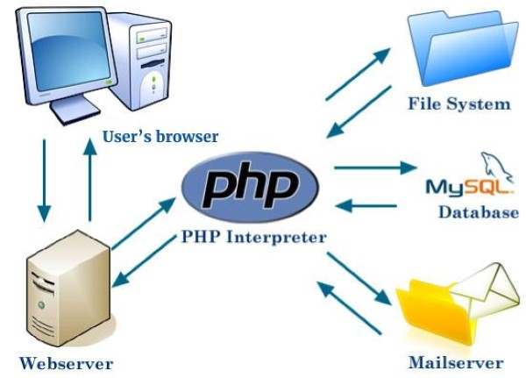
Working of PHP

Slide 12
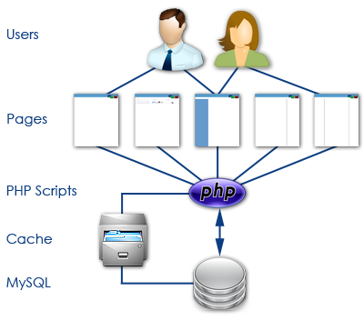

Slide 13
PHP Extension
FileName.php
“.php”

Slide 14
PHP First Program
<!DOCTYPE>
<html>
<body>
<?php
echo "<h2>Hello by PHP</h2>";
?>
</body>
</html>

Slide 15
2) Types Of Tags
<?
echo "Php Shot Tags <br> <br>”;
?>
<?php
echo "PHP Standard Tags <br><br>”;
?>
<script language = "php">
echo "Script Tags”;
</script>

Slide 16
3) Types OF php Comments
<?
# This is a comment, and
# This is the second line of the comment
// This is a comment too. Each style comments only
print "An example with single line comments";
/*
echo 'This is a test'; // This comment will cause a problem
*/
?>

Slide 17
4)echo Statement
echo is a statement i.e used to display the output. it can be used
with parentheses echo or
without parentheses echo.
echo can pass multiple string separated as ( , )
echo doesn’t return any value
echo is faster then print

Slide 18
5)Print Statement
Print is also a statement i.e used to display the output. it can be used with parentheses print( ) or without parentheses print.
using print can doesn’t pass multiple argument
print always return 1
it is slower than echo

Slide 19
6)PHP Variable Types
The main way to store information in the middle of a PHP program is by using a variable.
All variables in PHP are denoted with a leading dollar sign ($).
Variables are assigned with the = operator, with the variable on the left-hand side and the expression to be evaluated on the right.
PHP automatically converting types from one to another when necessary.
PHP has a total of eight data types which we use to Declare the variables.
Variable names must begin with a letter or underscore character.
A variable name can consist of numbers, letters, underscores but you cannot use characters like + , - , % , ( , ) . & , etc.
There is no size limit for variables.

Slide 20
Data-Types to Declare Variables
Integers: are whole numbers, without a decimal point, like 4195.
Doubles: are floating-point numbers, like 3.14159 or 49.1.
Booleans: have only two possible values either true or false.
NULL: is a type that only has one value i.e.. “NULL”.
Strings: are sequences of characters, like 'PHP supports string operations.'
Arrays: are named and indexed collections of other values.
Objects: are instances of programmer-defined classes, which can package up both other kinds of values and functions that are specific to the class.
Resources: are special variables that hold references to resources external to PHP (such as database connections).

Slide 23
8)PHP $ and $$ Variables
The $var (single dollar) is a normal variable with the name var that stores any value like string, integer, float, etc.
The $$var (double dollar) is a reference variable that stores the value of the $variable inside it.

Slide 24
07)Addition Of Two Sum…!

Slide 25
The escape-sequence
\n is replaced by the newline character
\r is replaced by the carriage-return character
\t is replaced by the tab character
\$ is replaced by the dollar sign itself ($)
\" is replaced by a single double-quote (")
\\ is replaced by a single backslash (\)

Slide 26
Variable Types
􏰀 09) Local variables
􏰀 10)Function parameters
􏰀 11)Global variables
􏰀 12)Static variables

Slide 27
13)PHP Magic constants
PHP provides a large number of predefined constants to any script which it runs.

Slide 28
PHP - Decision Making
14)if...else statement − use this statement if you want to execute a set of code when a condition is true and another if the condition is not true
15)elseif statement − is used with the if...else statement to execute a set of code if one of the several condition is true
16)switch statement − is used if you want to select one of many blocks of code to be executed, use the Switch statement. The switch statement is used to avoid long blocks of if..elseif..else code.

Slide 29
PHP - Decision Making
17)for − loops through a block of code a specified number of times.
18)while − loops through a block of code if and as long as a specified condition is true.
19)do...while − loops through a block of code once, and then repeats the loop as long as a special condition is true.
20)foreach − loops through a block of code for each element in an array.
21) Break

Slide 30
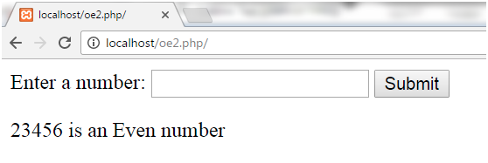
22)Even Odd Program
Logic:
Take a number.
Divide it by 2.
If the remainder is 0, print number is even.

Slide 31
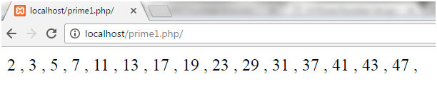
24) Prime Number
A number which is only divisible by 1 and itself is called prime number. Numbers 2, 3, 5, 7, 11, 13, 17, etc. are prime numbers.
2 is the only even prime number.
It is a natural number greater than 1 and so 0 and 1 are not prime numbers.

Slide 32
26)Table for Number
A table of a number can be printed using a loop in program.
Logic:
Define the number.
Run for loop.
Multiply the number with for loop output.

